Slide 1
Marketing automation in sectorul B2B
Codrin Teiu
Informatica Economica, An 2
Tehnologii informationale pentru automatizarea proceselor de marketing in afaceri

Slide 2
Marketing automation
“Marketing automation is the type of software that automates, streamlines, and manages marketing communications tasks throughout the buyer’s journey (Oracle, 2019)
“Marketing automation is technology that manages marketing processes and multifunctional campaigns, across multiple channels, automatically.” (Salesforce, 2019)
Software VS Proces

Slide 3
Functionalitati marketing automation
Email marketing
Raportare
Integrare: CRM, social media
Management al datelor si contactelor
Management al campaniilor de marketing: fluxuri de emailuri cu declansatoare complexe
Analiza

Slide 4
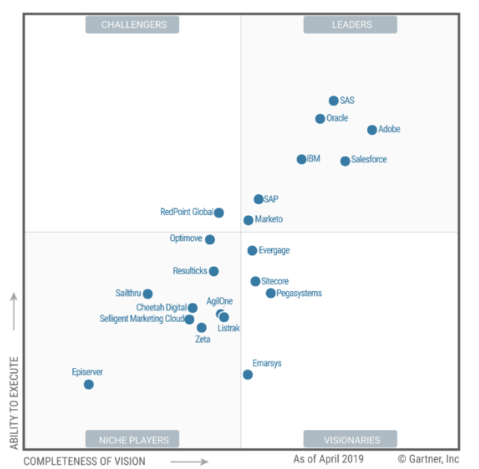
Piata de marketing automation
Gartner Magic Quadrant for MMH
Elkin, N., Sarner, A., Bloom, B., Enever, J. and Reid, C. (2019). Magic Quadrant for Multichannel Marketing Hubs. [online] Gartner.com. Available at: https://www.gartner.com/doc/reprints?id=1-6K72KDY&ct=190423&st=sb [Accessed 14 Sep. 2019].

Slide 5
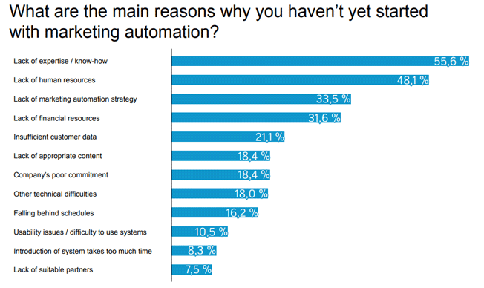
Implementarea
Liana, T. (2017). Survey: What are the Benefits of Marketing Automation? - Liana Technologies. [online] Liana Technologies. Available at: https://www.lianatech.com/blog/survey-what-are-the-benefits-of-marketing-automation.html [Accessed 14 Sep. 2019].

Slide 6
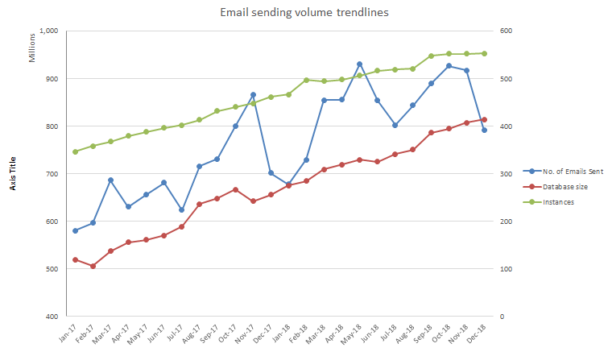
Utilizare
Instante
346 – 552
Baze de date
519 – 813 milioane contact
Emailuri trimise
579 – 800 milioane

Slide 7
Directii viitoare de cercetare
Analiza cantitativa a datelor cu privire la marimea bazelor de date, numarul de emailuri trimise, deschise, numarul de clickuri, vizite pe pagini si alti parametri;
    Profilare client, clusterizare produse/servicii.
Analiza factorilor de success in automatizarea proceselor de marketing in afaceri;
    Chestionar
    Interviuri

